Slide 1

IDA & ML I Spam Filter
Juan Danza
Potsdam University
Sep 18, 2025

Slide 2
Problem Setting
Spam Detection: Binary Classification Problem (Supervised)
Input Attributes: Numerical Count of Words
Target Variable: Spam or not Spam (1/0)
Requirements: Less than 0.2% False Positive Rate, Highest Recall as possible.

Slide 3
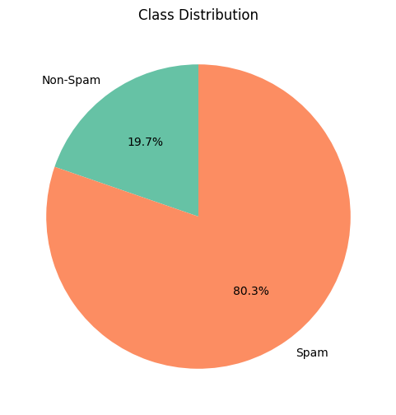
Data Overview
10000 examples.
57.173 features.
Bag of words (independent).
Class distribution? Are we under covariate shift?
Notes:
Possible problems:
Class bias
Bag of words is limiting, in features (new vocabulary like in crypto), models that can be used, and combining additional datasets. Brings independent observations, while language is a sequence.
Not clear if the data is representative or not.
Spam amounts can change over time.

Slide 4

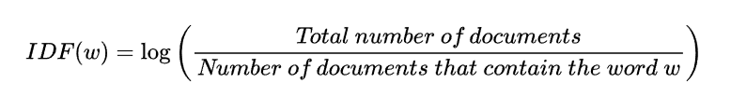
Feature Extraction
Already Bag of Words
n-Grams and vectorization of words are not a choice.
TF-IDF

Slide 5
Model Selection
Possible models according to the literature*:
Naïve Bayes
Random Forest
Logistic Regression
SVM
*Kaddoura, S., Chandrasekaran, G., Popescu, D.E., & Duraisamy, J.H. (2022). A systematic literature review on spam content detection and classification. PeerJ Computer Science, 8.,
Muath AlShaikh, Yasser Alrajeh, Sultan Alamri, Suhib Melhem & Ahmed Abu-Khadrah (2025) Supervised methods of machine learning for email classification: a literature survey, Systems Science & Control Engineering, 13:1, DOI: 10.1080/21642583.2025.2474450

Slide 6
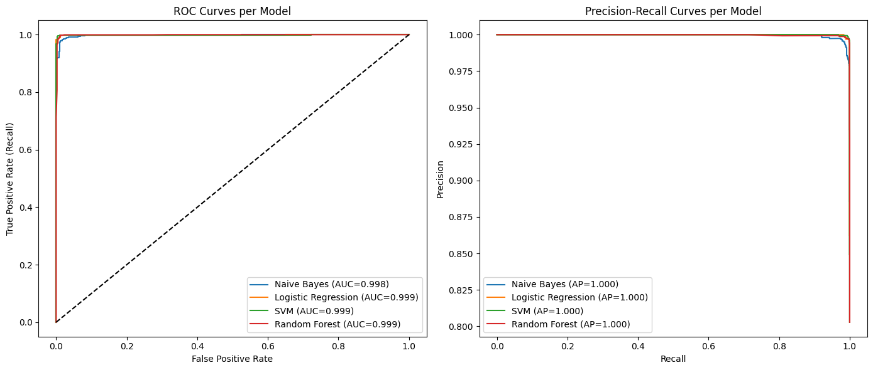
Model Selection

Slide 7
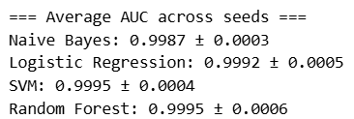
Model Selection

Slide 8
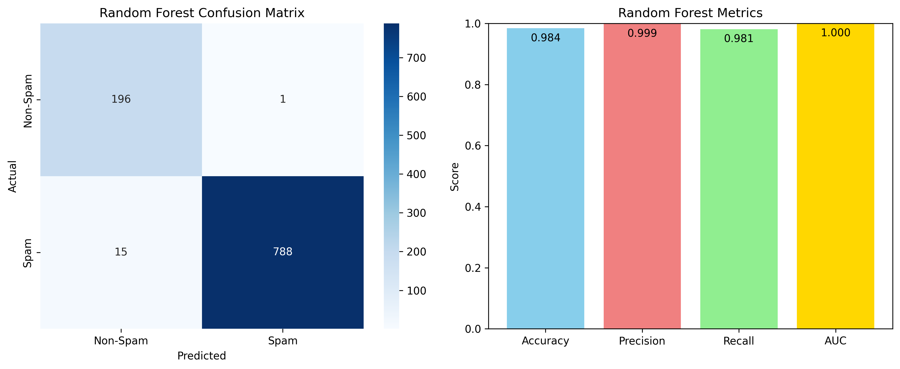
Results RF
FP Rate: 0.51%

Slide 9
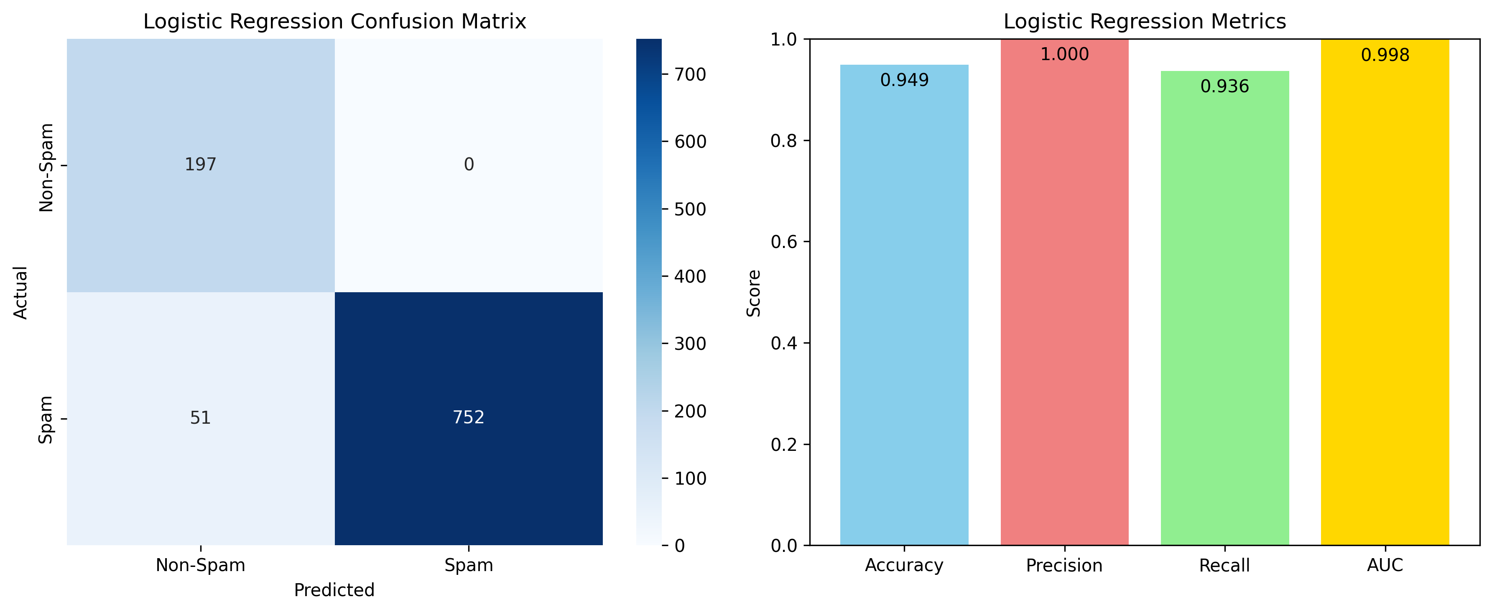
Results Logistic Regression
FP Rate: 0.0%

Slide 10

Results SVM
FP Rate: 0.0%

